Slide 1
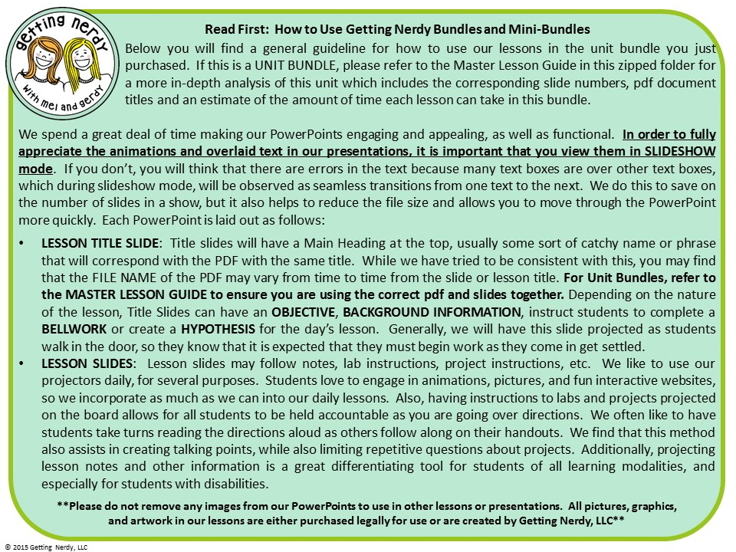

Slide 2


Slide 3


Slide 4
Oh Baby, YOOOOOU, you got what I neeeeed…
The Needs & Characteristics of Living Things
Objective: To describe the characteristics and needs of all living things
Bell work:
What characteristics make something alive?
Let’s Discuss!
© Getting Nerdy, LLC

Slide 5
The Needs & Characteristics of Living Things
What You Do: On your handout, fill in the graphic organizer with the NEEDS of living things.
Hmmmm… what DO I need?...
© Getting Nerdy, LLC

Slide 6
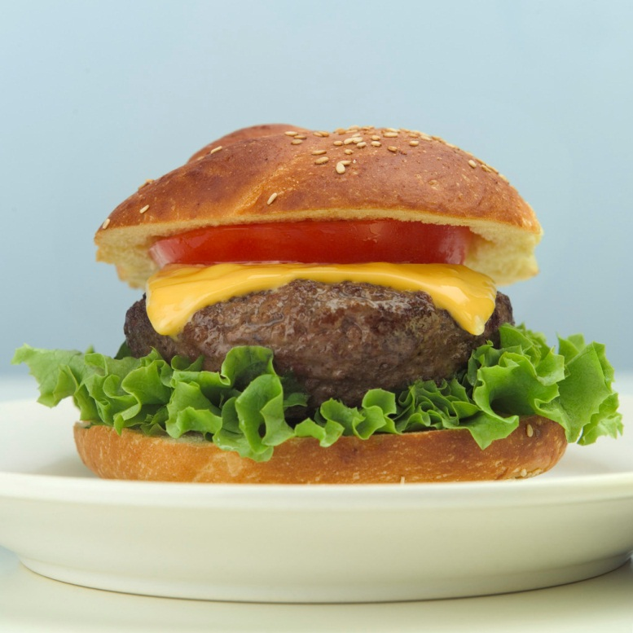
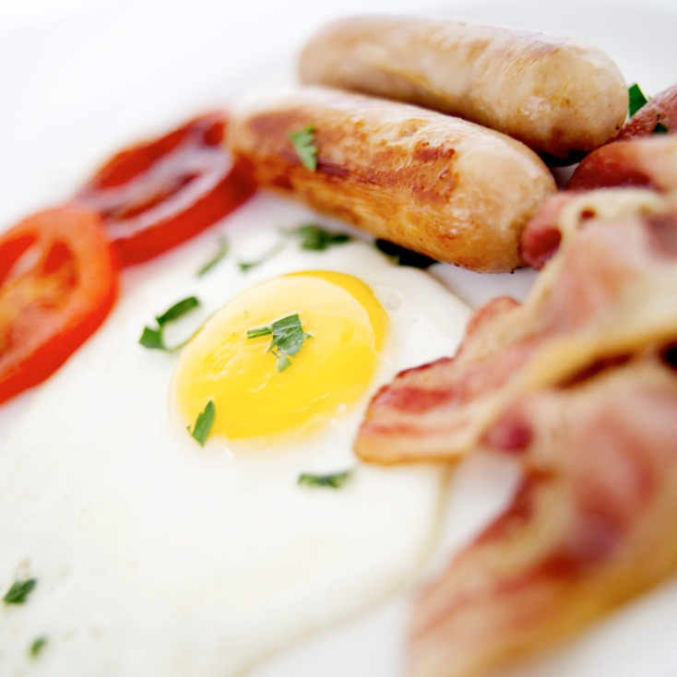
All Living Things NEED:
FOOD
It provides organisms with energy for life functions. Depending on how you get food, you can be:
Autotroph/Producer
  plants and some bacteria
Heterotroph/Consumer
  Carnivores: eat animals
  Herbivores: eat plants
  Omnivores: eat plants and animals
© Getting Nerdy, LLC

Slide 7
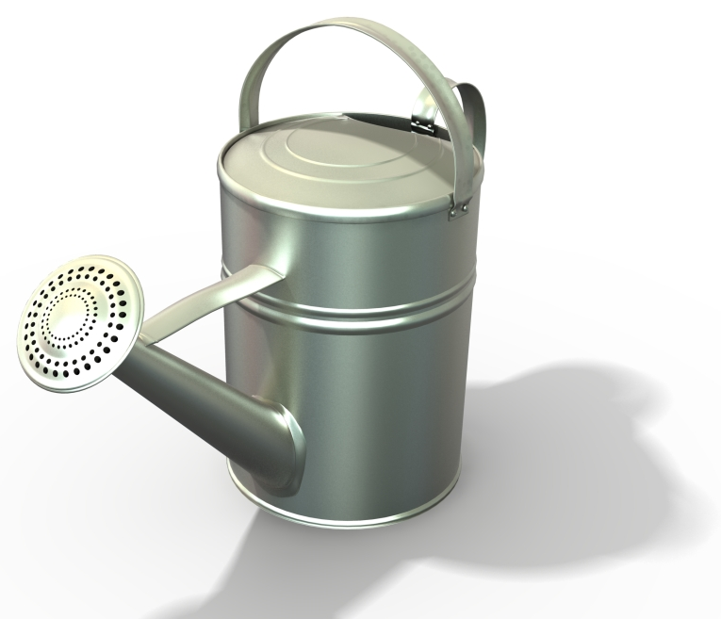
All Living Things NEED:
WATER
It helps organisms to:
Break down food
Grow
Move substances within their bodies
Reproduce
© Getting Nerdy, LLC

Slide 8
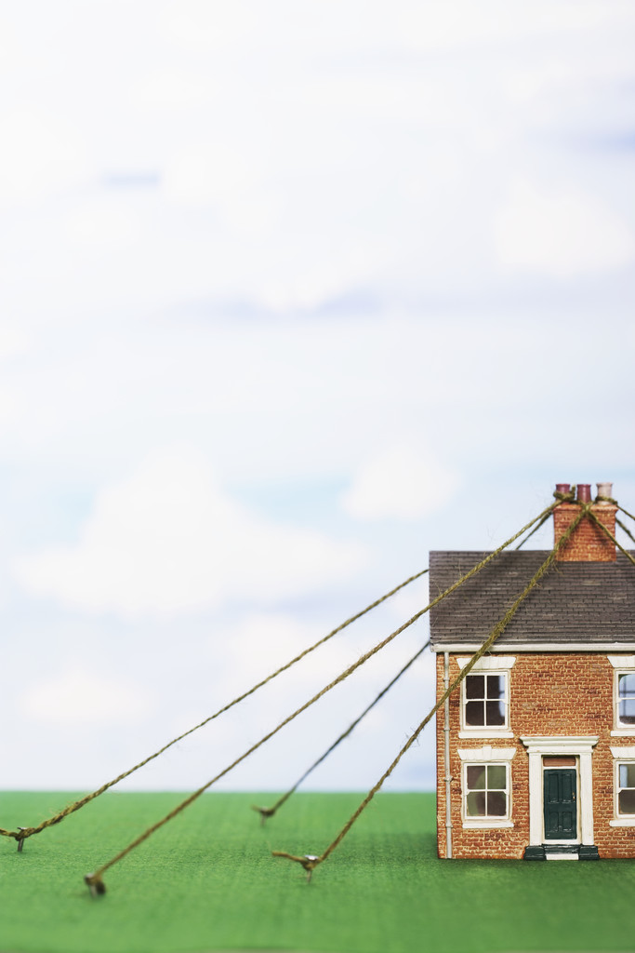
All Living Things NEED:
SPACE TO LIVE
It provides organisms with:
A place where they can get food, water, find shelter
Organisms often compete for space
© Getting Nerdy, LLC

Slide 9
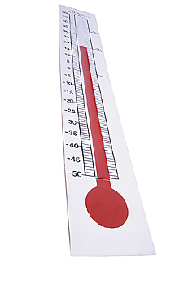
All Living Things NEED:
THE ABILITY TO MAINTAIN HOMEOSTASIS
It allows organisms to:
maintain stable conditions inside the body
  Control temperature
  Control the amount of water
maintain cell functions
© Getting Nerdy, LLC

Slide 10
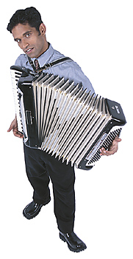
CHARACTERISTICS OF LIVING THINGS
Let’s create a foldable to keep track of our notes on living things.
Obtain a square piece of paper and let’s get started…
© Getting Nerdy, LLC

Slide 11
What’s Behind Door Number…
The Diamond 4 Door
Fold each corner of the square so that the opposite corners touch. When folded correctly, the paper will reveal an “X”
Fold all of the corners of the square into the center of the X
Voila! You should have a four door foldable!
1.
2.
3.
© Getting Nerdy, LLC

Slide 12
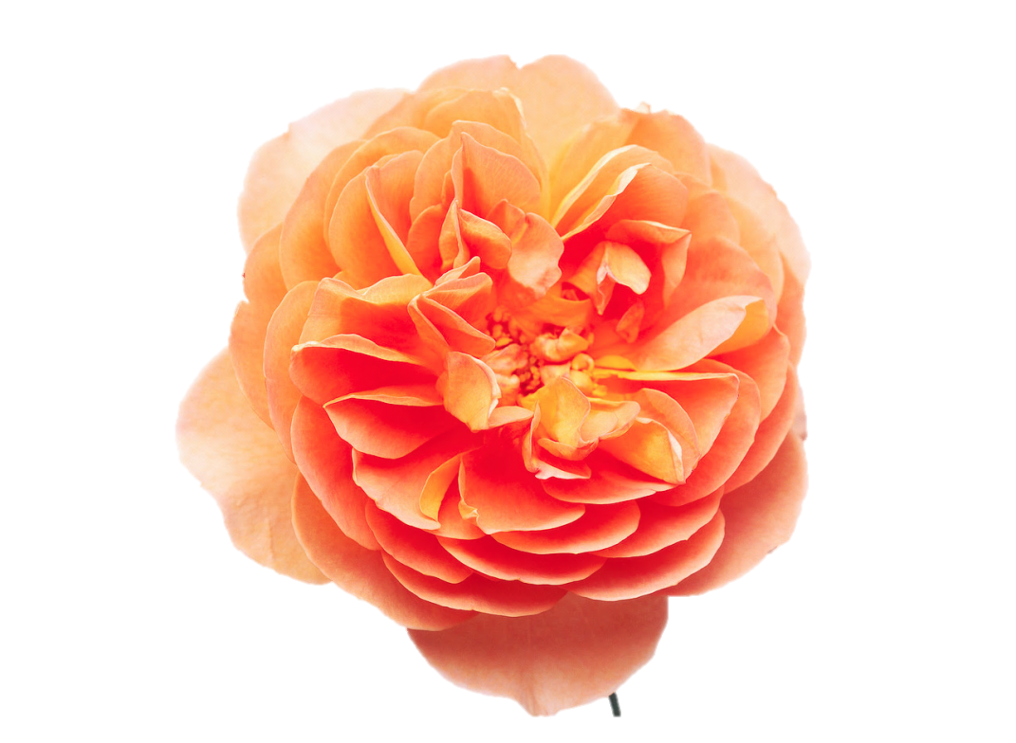
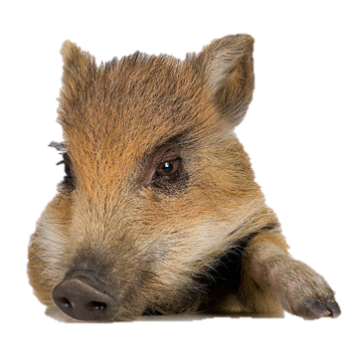
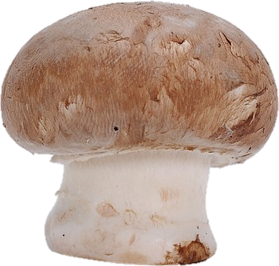
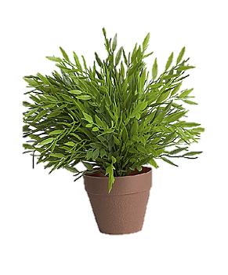
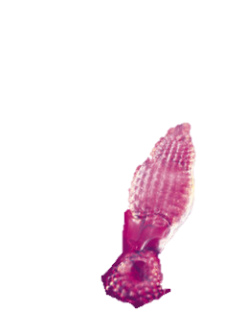
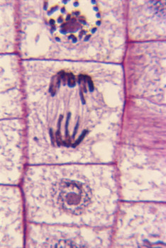
Characteristics of Living Things
Pick any flap and on the outside of that flap, write these words:
The Characteristics of Living Things
Lift the flap and on the square underneath the flap, write:
All organisms share the following characteristics:
© Getting Nerdy, LLC

Slide 13

Now, cut the remaining three flaps down the center (in this picture, on the dotted lines) toward the fold to reveal six smaller flaps.
Now that you have created six flaps, you will write the notes for each characteristic under each flap and draw what it looks like on the outside of the flap
The Characteristics of Living Things
Flap #1
1
6
Flap #2
Flap #4
2
5
3
4
Flap #3
© Getting Nerdy, LLC

Slide 14
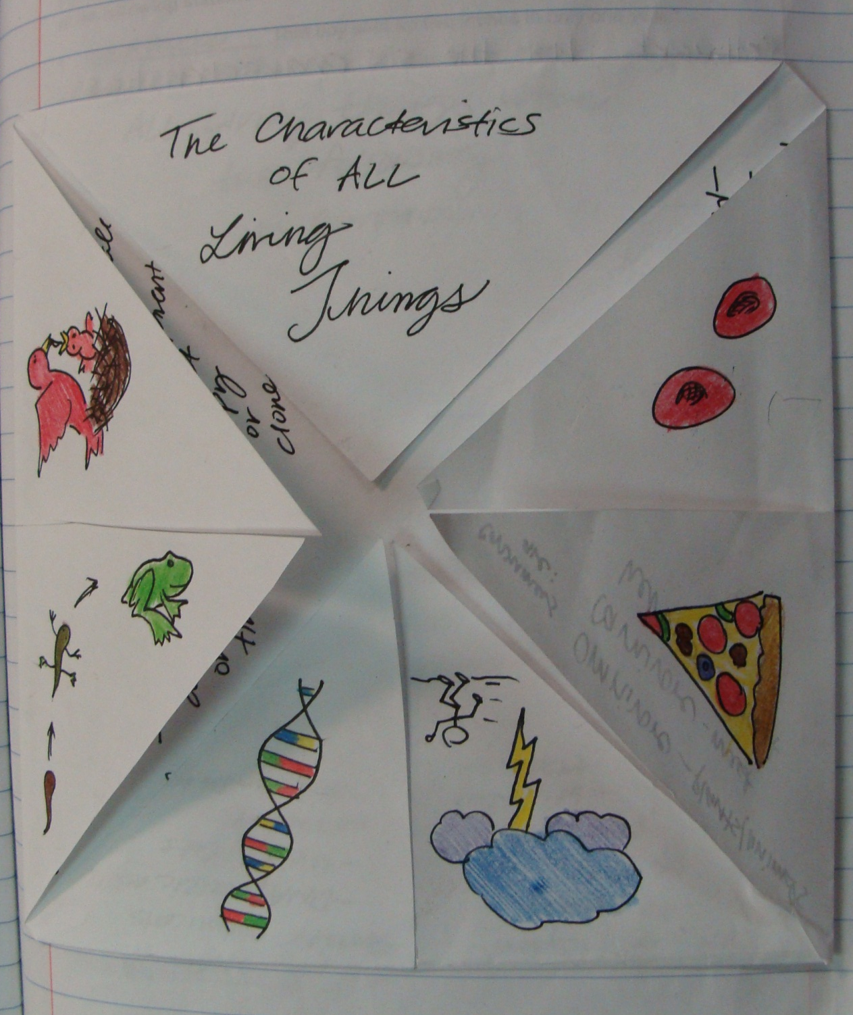
Here’s an example of what it will look like when we’re all done:
© Getting Nerdy, LLC

Slide 15
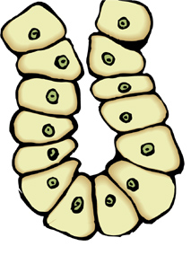
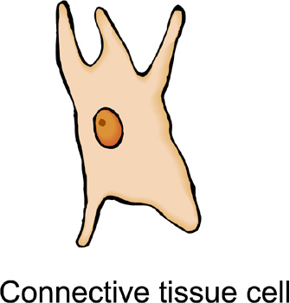
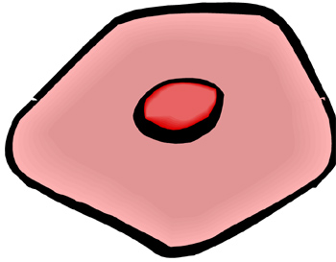
Choose a flap and keep all other flaps closed. Under the flap, write the following characteristic:
Made of Cells
Organisms can be:
Unicellular - simple
Multicellular - complex
© Getting Nerdy, LLC

Slide 16
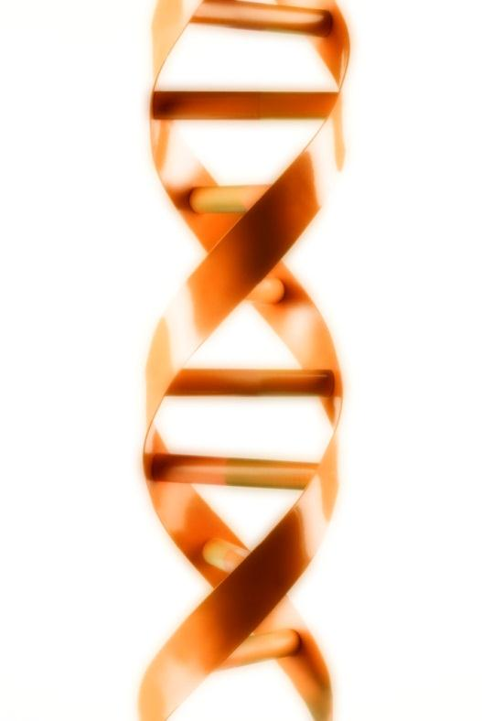
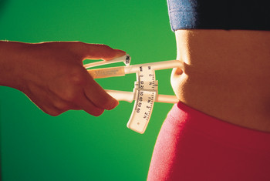
Choose a flap and keep all other flaps closed. Under the flap, write the following characteristic:
Share Similar Chemicals
Organisms have:
DNA - nucleic acids
Protein
Lipids - fat
Carbohydrates - energy
© Getting Nerdy, LLC

Slide 17

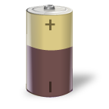
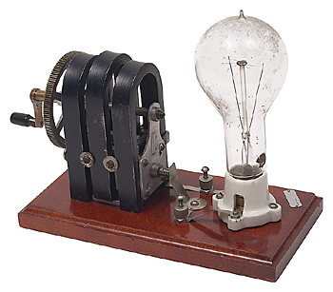
Choose a flap and keep all other flaps closed. Under the flap, write the following characteristic:
Take in and Use Energy
Energy allows organisms to:
Make organs work
Repair/replace cells
© Getting Nerdy, LLC

Slide 18
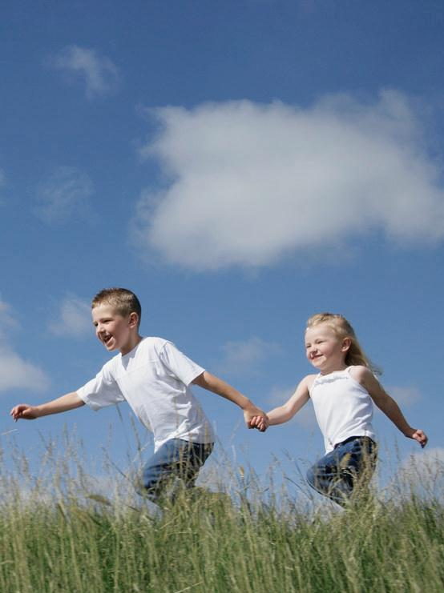
Choose a flap and keep all other flaps closed. Under the flap, write the following characteristic:
Sense & Respond to Changes in the Environment
Stimulus: activity that brings about a response
Response: result of the stimulus
RUN!
© Getting Nerdy, LLC

Slide 19
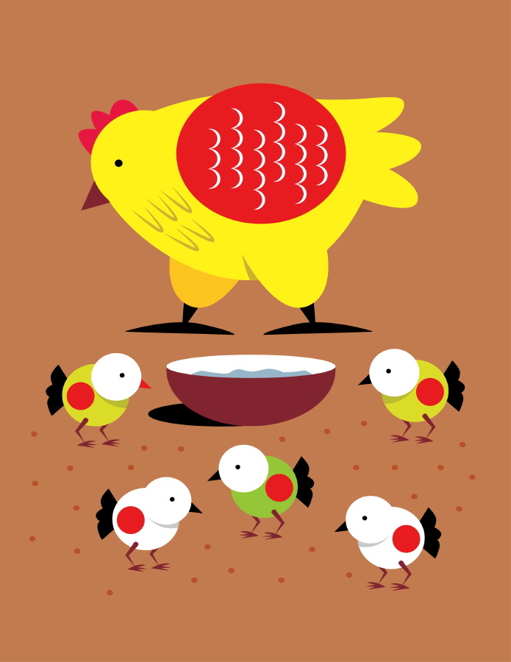
Choose a flap and keep all other flaps closed. Under the flap, write the following characteristic:
Reproduce
Organisms make offspring:
Sexually: mother & father
Asexually: one parent (offspring is identical to parent, also called a clone)
© Getting Nerdy, LLC

Slide 20
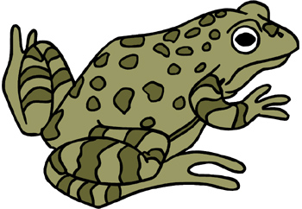
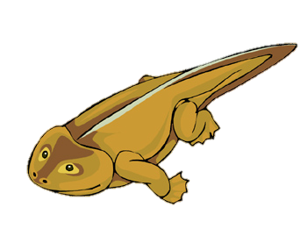
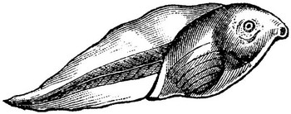
Choose a flap and keep all other flaps closed. Under the flap, write the following characteristic:
Grow & Develop
Organisms:
Grow larger by cells multiplying in number
Development is change (tadpole frog)
© Getting Nerdy, LLC

Slide 21
Now, on the outside of each flap, draw a picture of what each characteristic looks like to YOU!
© Getting Nerdy, LLC

Slide 22
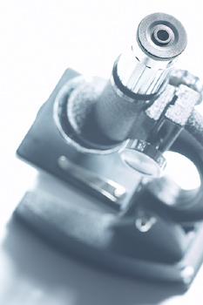
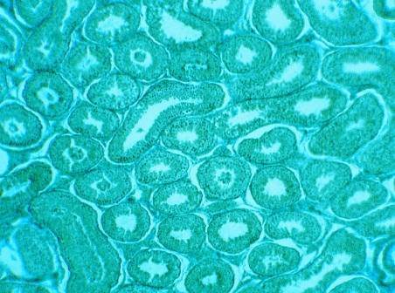
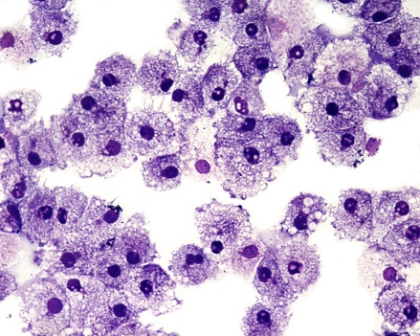
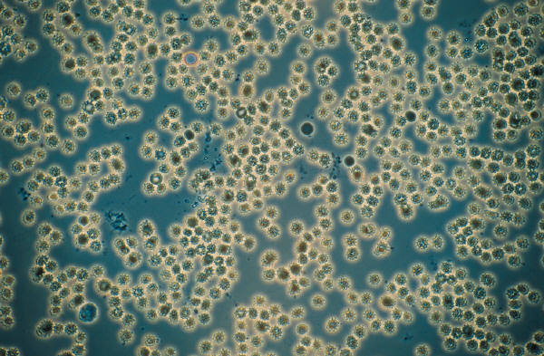
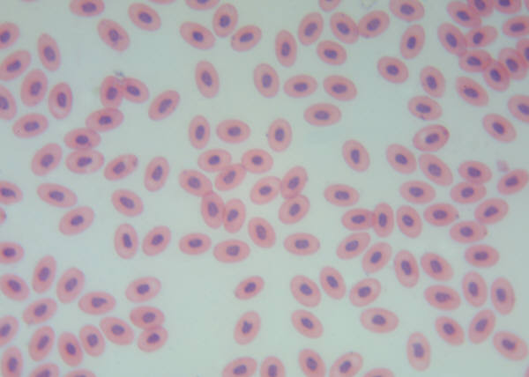
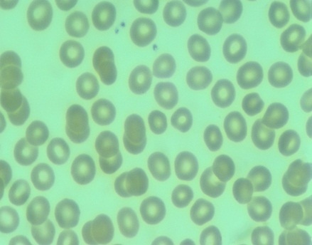
Life Under the Microscope
Objective: To determine how living things are organized.
Bell work:
What is another name for a living thing?
Organism
© Getting Nerdy, LLC

Slide 23
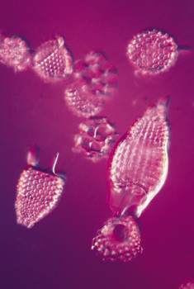
Take a few minutes to read the passage “Life under the Microscope.”
When complete, find the correct term for the definitions on your sheet. Remember to use good reading strategies as you read!
© Getting Nerdy, LLC

Slide 24

Levels of Organization
Let’s learn about how living things are organized…
© Getting Nerdy, LLC

Slide 25
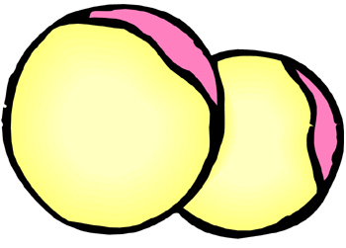
Fat Cells
Skin Cell
Cell
Smallest working unit that serves a specific job or function. Some may live alone, like bacteria which are unicellular
How does the shape of each cell relate to its function?
Connective Tissue Cell
Gland Cells
Muscle Cells
Red Blood Cells
Cartilage Cells
Bone Cells
© Getting Nerdy, LLC

Slide 26
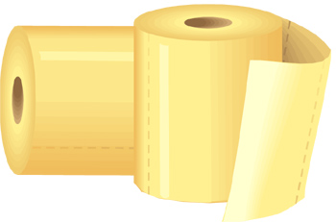
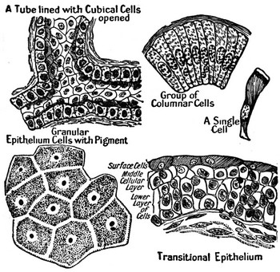
Tissue
Made of several cells similar in structure & function that work together to perform a specific job
Humans have FOUR basic tissues: connective (fat, cartilage, bone, blood); epithelial (skin), nervous and muscular
Wait! Not THAT kind of tissue!
Several bone cells make up a tissue…
© Getting Nerdy, LLC

Slide 27
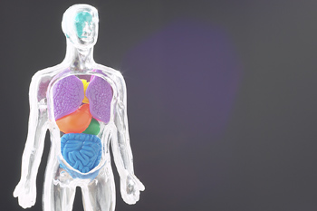
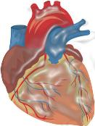
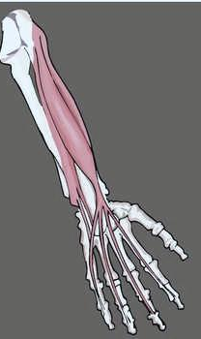
Tissues of the Human Body
Cardiac Muscle
Epithelial Tissue
Striated Muscle
Smooth Muscle
© Getting Nerdy, LLC

Slide 28
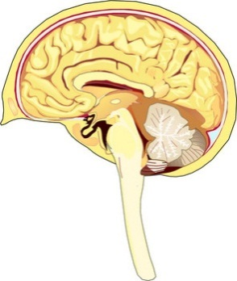
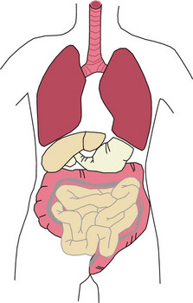
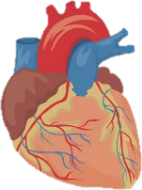
Organ
Made of similar tissues that work together to perform a specific activity
What other organs can you think of?
© Getting Nerdy, LLC

Slide 29
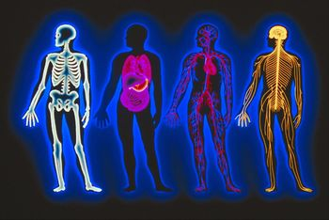
Organ System
Groups of one or more organs working together to perform functions for the organism.
Our human body has 11 organ systems. Can you name them?
© Getting Nerdy, LLC

Slide 30
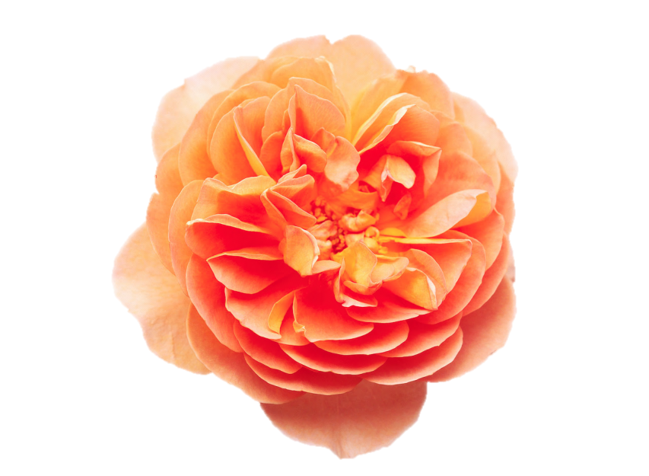
Organism
Entire living thing that carries out all basic life functions.
Meaning… it’s made of cells, shares similar chemicals, can take in and use energy, grow & develop, reproduce, and sense & respond to the environment. Most organisms are made up of many cells but some consist of only one cell such as bacteria.
© Getting Nerdy, LLC

Slide 31
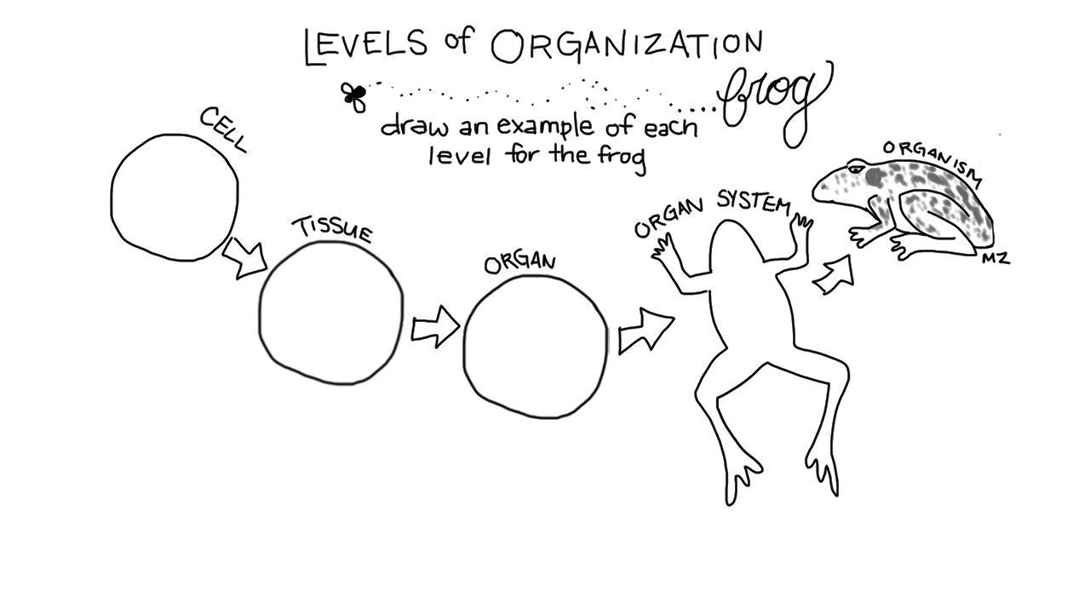
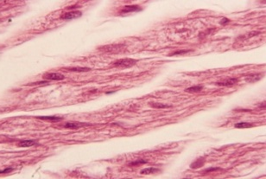

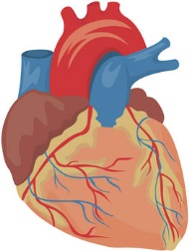
Let’s create the levels of organization for a frog. Each level must build upon the previous level. For example, if you draw a cardiac muscle cell, then you should draw cardiac muscle tissue, a heart, & the cardiovascular system.
Cellular level (muscle cell)
Organism level (consisting of many organ systems)
Organ system level (cardiovascular system)
Tissue level (muscle tissue)
Organ level (heart)
© Getting Nerdy, LLC

Slide 32

Let’s CHANT about the Levels of Organization!
Clap your hands everybody, and everybody clap your hands! We’re gonna chant about the cell, and everybody YELL…
WHAT!?
Teachers, be sure to turn up your volume for this slide!
© Getting Nerdy, LLC

Slide 33
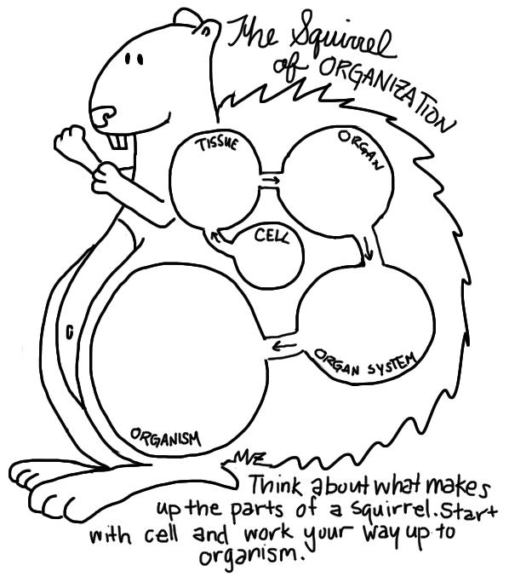
Now it’s your turn…
In each circle, draw a colorful picture to match the specific level. For example, in the circle labeled “cell”, draw a picture of a specific type of cell you might find in a squirrel.
© Getting Nerdy, LLC

Slide 34
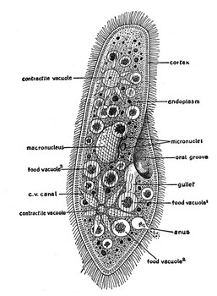
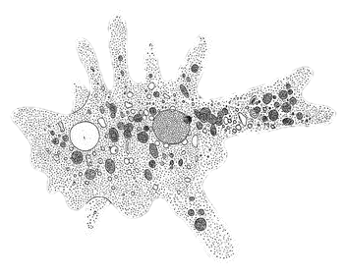
Cell Structure:
Cell Organelle Graphic Organizer
Objective: To determine the structure and function of cell organelles.
Bell work: List in order the levels of organization and provide an example of each.
Cell-tissue-organ-organ system-organism
© Getting Nerdy, LLC

Slide 35

Cell Theory tells us…
All living things are made of cells.
Cells are the smallest working units of all living things.
Cells come from pre-existing cells through cell division.
© Getting Nerdy, LLC

Slide 36




What is a Cell?
A cell is the smallest unit that is capable of performing life functions – i.e. has all of the characteristics of living things.
Notice how the shape of the cell determines what its function is…
Egg or Ovum
Sperm Cell
Smooth Muscle Cell
Neuron
Red Blood Cell
White Blood Cell
Osteocyte or Bone Cell
Connective Tissue Cell
Intestinal Cell
Epithelial Cell from Cheek
© Getting Nerdy, LLC

Slide 37



Examples of Cells
Elodea Leaf Cell
Amoeba Proteus
Nerve Cell
Red Blood Cell
© Getting Nerdy, LLC

Slide 38

Characteristics of Prokaryotic Cells
Simple, unicellular organisms
Do not have membrane-bound organelles
Bacteria ONLY!
Includes Kingdoms Eubacteria and Archaebacteria
We like to say “PRO?” “NO!”… meaning NO nucleus, NO organelles
Bacteria Cell
© Getting Nerdy, LLC

Slide 39


Plant Cell
Characteristics of Eukaryotic Cells
Complex organisms - most living things
Can be unicellular or multicellular
Contain organelles surrounded by membranes
For this, We like to say “EU (YOU)?” “TRUE!”… meaning TRUE nucleus, TRUE organelles
Animal Cell
© Getting Nerdy, LLC

Slide 40
Make your own analogy!
For each organelle on the following slides, HIGHLIGHT or UNDERLINE the BOLD-FACED WORDS - they’re important!
Then, think of a picture analogy that will help you to remember the organelle and what it does! You will draw this in the last column of your organizer.
The first one is already done for you!
© Getting Nerdy, LLC

Slide 41




Cell Membrane
All Prokaryotic & Eukaryotic cells
Structure:
Located on outside of cell.
Made of phospholipid bilayer: phosphates and lipids (fats)
Function:
Determines what goes in/out of cell
Protects and supports cell
Cell Membrane
What if this organelle were missing from the cell?
Materials could go in and out unfiltered
Cell would lack structure
NO ENTRY!
© Getting Nerdy, LLC

Slide 42
Cell Membrane: The Phospholipid Bilayer is semi-permeable, meaning it allows some materials to pass through freely, while other materials cannot.
© Getting Nerdy, LLC

Slide 43


Cytoplasm
All Prokaryotic & Eukaryotic cells
Structure:
Jelly-like material found inside cell membrane
Function:
Supports and protects cell’s organelles. Contains some nutrients for cell
Cytoplasm
What if this organelle were missing from the cell?
Organelles would have no protection
Nutrients could not diffuse through cell
mmm…jelly doughnut!
© Getting Nerdy, LLC

Slide 44



Nucleus/Nucleolus/DNA
ONLY in Eukaryotic cells (Prokaryotes have Free-floating DNA not bound by a nucleus)
Structure:
Has a nuclear membrane to allow materials in and out
Contains genetic material – DNA (chromosomes) which contain instructions for traits
Contains dark central ball called the nucleolus (makes ribosomes)
Function:
Directs cell activities
Nucleus/Nucleolus/DNA
What if this organelle were missing from the cell?
Cell could not function
No direction for organelles
and… ACTION!
© Getting Nerdy, LLC

Slide 45

Ribosome
All Prokaryotic & Eukaryotic cells
Structure:
Not bound by a membrane
Each cell contains thousands (little BLACK dots in the pictures to the right)
Found on endoplasmic reticulum & freely floating throughout cell
Function:
Makes protein
Ribosome
What if this organelle were missing from the cell?
Cells would not have building blocks to create organelles, etc.
ORDER UP!
© Getting Nerdy, LLC

Slide 46


Mitochondria
All Eukaryotic Cells
Structure:
Rod shaped and found throughout cell
Function:
“Powerhouse” of cell
Produces energy from sugar through chemical reactions (Cellular Respiration)
Mitochondria
What if this organelle were missing from the cell?
Cells would not be able to create energy to perform functions
I’ve got the POWER!
© Getting Nerdy, LLC

Slide 47



Chloroplast
Eukaryotic Plant cells ONLY
Structure:
Found in plant cells
Contains green chlorophyll
Function:
Photosynthesis uses sunlight to make sugar for plant
Chloroplast
What if this organelle were missing from the cell?
Plants would not be able to make food
I’m Sweet!
© Getting Nerdy, LLC

Slide 48



Golgi Bodies
(aka Golgi Apparatus or Golgi Complex)
All Eukaryotic Cells
Structure:
Made of 5-8 sacs Function:
Processes and packages proteins & lipids
Move materials within the cell and out of the cell in small sac called “vesicle”
Golgi Bodies
What if this organelle were missing from the cell?
Cell would not be able to package or transport materials efficiently
Pack it up, Move it out!
© Getting Nerdy, LLC

Slide 49



Endoplasmic Reticulum
All Eukaryotic cells
Structure:
Series of tubes and sacs
  Smooth: without ribosomes
  Rough: with ribosomes
Function:
Transports proteins and breaks down drugs in the cell
Endoplasmic Reticulum
What if this organelle were missing from the cell?
Some ribosomes would not have a home
Proteins would not have a system of transport
All Aboard!
© Getting Nerdy, LLC

Slide 50



Lysosome (Animal)
Lytic Vacuole (Plant)
All Eukaryotic Cells
Structure:
Vesicle built by the Golgi bodies
Function:
Digests excess or worn out organelles, food particles, and engulfed viruses or bacteria.
“Disposal” of the cell
Lysosome
What if this organelle were missing from the cell?
Cells would not be able to break down materials
Break it DOWN!
© Getting Nerdy, LLC

Slide 51



Vacuole
All Eukaryotic cells
Structure:
LARGE in plant cells, small in animal cells.
Contains water & nutrients
Function:
Help plants maintain shape
Storage, digestion, & waste removal
Vacuole
What if this organelle were missing from the cell?
Cell would not have a storage area for water, food, etc.
Plant cells would lose shape
Let’s go for a dip!
© Getting Nerdy, LLC

Slide 52



Cell Wall
All Prokaryotic Cells & Eukaryotic PLANT Cells ONLY
Structure:
Found only in plant cells & bacteria cells
Function:
Supports & protects cells
Cell Wall
What if this organelle were missing from the cell?
Plant and bacteria cells would lack support and protection
Need some support?
© Getting Nerdy, LLC

Slide 53
Let’s Compare…
In both Prokaryotes and Eukaryotes:
Only in Eukaryotes:
Chloroplast
Mitochondria
Cell Wall – Bacteria and Plants
Genetic Material - DNA
Ribosome
Cell Membrane
Cytoplasm
Golgi Bodies
Vacuole
Lysosome/Lytic Vacuole
Endoplasmic Reticulum
© Getting Nerdy, LLC

Slide 54
How many can you remember?
Lysosome/Lytic Vacuole
Nuclear Membrane
DNA
Nucleolus
Ribosome
Endoplasmic Reticulum
Mitochondria
Vacuole
Golgi Bodies
Cytoplasm
Cell Membrane
© Getting Nerdy, LLC

Slide 55
What You Do:
First, take a moment to identify the organelles present in each cell. For each organelle that is present, color the box in the column the designated color for that organelle. Remember, some cells share the same organelles, so you may have a check for each cell type below depending on the organelle.
Create Your Cells:
Now, using the information above, color the cells on the back of your page following the color key in the table above. Be careful and pay attention to the number identification provided for you for each cell. Remember, if you color one item a certain color, everything else that looks like that item should also be that color as well.
Check Your Work…
 |  | Present in the cell?
Organelle | Color | Bacteria | Plant | Animal
1. Cell membrane | Purple
2. Cytoplasm | White
3. DNA (in Eukaryotic Cells includes Nucleus. Nucleolus, and nuclear membrane) | Orange
4. Ribosome | Black (already colored)
5. Mitochondria | Red
6. Vacuole | Light Blue
7. Golgi Body | Yellow
8. Endoplasmic Reticulum | Dark Blue
9. Lysosome/Lytic Vacuole | Pink
10. Chloroplast | Dark Green
11. Cell Wall | Light Green
X
X
X
X
X
X
(No Nucleus )
X
(Has a Nucleus )
X
(Has a Nucleus )
X
X
X
X
X
X
X
X
X
X
X
X
Lytic Vacuole
Lysosome
X
X
X
© Getting Nerdy, LLC

Slide 56

For Homework Tonight:
Write the following directions in your agenda:
Pick your favorite organelle from our lesson today, and create a short comic strip of that organelle as a superhero or comic book character performing it’s job. Your comic should be at least 5 panels. Creativity, coloring, and the job it performs will all be factors in your grade!
© Getting Nerdy, LLC

Slide 57


Cell Comparison: Bacteria, Plant & Animal Cells
Objective: To identify the locations of prokaryotic and eukaryotic cell organelles.
Bell work: Why is the location of the nucleus important to the function of the cell?
Because the nucleus is responsible for controlling all of the cell’s activities and a central location ensures that all organelles will receive messages in a timely manner.
© Getting Nerdy, LLC

Slide 58
Location, Location, Location…
Why are the organelle locations important?
Think about their jobs and let’s discuss…
Where is the nucleus? What does it do?
Where is the nucleolus? What is it’s job?
Where are the ribosomes? Why are they important?
What about the Endoplasmic Reticulum? What does it transport?
© Getting Nerdy, LLC

Slide 59
Location, Location, Location…
The nucleus is the control center of the cell. It is located in the center because of the need to send messages via proteins and other chemicals at the same rate to all other organelles within the cell. If it were located at the edge of the cell, organelles at the opposite edge would not receive messages as quickly as those located near the nucleus itself.
© Getting Nerdy, LLC

Slide 60
Location, Location, Location…
The nucleolus inside the nucleus makes ribosomes. Those ribosomes are then sent out of the nucleus through the pores in the nuclear membrane where they may be free floating throughout the cell or attach themselves to the E.R. Because the ribosomes make proteins, it makes sense that they are attached to the E.R. which transports proteins to other parts of the cell. And because the nucleolus makes ribosomes, it makes sense that the E.R. is located around the nucleus, to receive the ribosomes as they exit through the nuclear membrane.
Location is IMPORTANT!
© Getting Nerdy, LLC

Slide 61
Cell Comparison: Bacteria, Plant & Animal Cells
You wouldn’t know it by looking at them, but Prokaryotes and Eukaryotes have a lot in common! Bacteria, plants and animals share a lot of the same organelles. This activity will help you to see the similarities and differences between the basic cell structures. Be sure to follow the directions for coloring in order to make those connections between the cells.
© Getting Nerdy, LLC

Slide 62
Microscope Madness:
These Things Are Crazy Small!
Objective: To identify the structures and functions of the microscope and how to use it.
Bell work: If you were to make a microscope out of household materials, what do you think you would need?
A tube, lens/lenses, mirrors
© Getting Nerdy, LLC

Slide 63





Microscope History
1000 A.D.: First use of lenses to view Greek & Roman writings.
1590 A.D.: Hans & Zacharias Janssen make the first microscope by placing two lenses in a tube.
1665 A.D.: Robert Hooke - first to describe and use the phrase "cell" when observing a slice of cork using a microscope power of 30X.
1675 A.D.: Anton van Leeuwenhoek “father of microscopy” uses a simple microscope with one lens and is the first to describe bacteria.
Victor Hugo once said: “Where the telescope ends, the microscope begins. Which of the two has a grander view?” What do YOU Think he meant?
© Getting Nerdy, LLC

Slide 64

Let’s Get Familiar with the parts of the Microscope…
Eyepiece
Body Tube
Arm
Revolving Nosepiece
High Objective 40X
Low Objective 4X
Stage Clips
Middle Objective 10X
Stage
Coarse Adjustment Knob (used in Low Power ONLY)
Iris Diaphragm
Fine Adjustment Knob
(used in Med/High Power)
Lamp
Base
© Getting Nerdy, LLC

Slide 65
Microscope Madness - Vocabulary
Check your work!
________________ A hollow tube that holds the eyepiece lens and/or mirrors.
________________ This holds the objective lenses and rotates to use different lenses.
________________ The objective with power of 10x
________________ The objective with power of 4x - Smallest objective
________________ The objective with power of 40x - Longest objective.
________________ These hold the slide in place.
________________ Located under the stage, this controls how much light shines through the stage to illuminate the specimen.
________________ This provides the light that shines through the slide.
________________ The part you look through – also has a 10x lens in it.
________________ This supports the body tube and makes a good handle for carrying the microscope.
________________ It’s the place where you place the slide for viewing.
________________ Knob used for finding stuff under low power – moves the stage up and down, too.
________________ Knob used for high-power focusing.
________________ This supports the weight of the microscope.
Body Tube
Nosepiece
Middle Objective
Low Objective
High Objective
Slide Clips
Iris Diaphragm
Lamp
Eyepiece
Arm
Stage
Coarse Adjustment
Fine Adjustment
Base
© Getting Nerdy, LLC

Slide 66
Microscope Madness
Referring back to the quote in the Microscope History passage, what do you think Victor Hugo meant by “where the telescope ends, the microscope begins”?
Let’s discuss…
Which do you feel has a grander view?
Let’s discuss…
Find the Total Magnification for each objective lens using the following equation:
Total Magnification = Eyepiece (10x) X Objective (# on Objective lens)
objective = 4x
10 X 4 = 40; 40 times the vision of the naked eye
objective = 10x
10 X 10 = 100; 100 times the vision of the naked eye
objective = 40x
10 X 40 = 400; 400 times the vision of the naked eye
© Getting Nerdy, LLC

Slide 67


Microscope Madness
When finding your specimen for the first time, you always want to use the Coarse Adjustment Knob and have the microscope in LOW Power. This provides a greater field of view to locate your specimen.
Then, when you’re ready to zoom in more, switch to MEDIUM and HIGH power and use the FINE adjustment knob. This will lessen your field of view, but give you a more detailed picture of what you’re looking at! NEVER use the COARSE Adjustment knob on medium or high power! You’ll break the lens or your slide!
© Getting Nerdy, LLC

Slide 68

Microscope Madness
So, let’s say you need to take the microscope across the room to your station. What’s the best way to carry it?
We like to say “tucked in like a football”, with one hand under the base and one securely around the arm of the microscope.
© Getting Nerdy, LLC

Slide 69

Microscope Madness:
Newspaper “e” Microscope Lab
Objective: To learn how to use a compound microscope.
Here’s what the letter “e” from a newspaper looks like on a prepared microscope slide. Use this image to help you prepare the slide and to answer the following questions.
What You Do: Preparing the slide
Cut out a letter “e” from a section of newspaper.
Place it in the center of a glass slide facing the normal reading position.
Cover with a glass cover slip.
Using an eye dropper, place a drop of water at the edge of the cover slip and watch as the water travels under the cover slip and secures the two pieces of glass together.
© Getting Nerdy, LLC

Slide 70
Microscope Madness:
Newspaper “e” Microscope Lab
Hypothesis:
We know that microscopes make images appear larger and more detailed. What else do you think might happen to the image of the letter “e” when looked at through the microscope?
Data and Conclusions:
Follow all directions on your handout and answer any questions that follow. Be sure to draw what you SEE in the circles. Science is all about communicating your observations in pictures and words, so it is important to be accurate and thoughtful when describing what you see.
© Getting Nerdy, LLC

Slide 71

What You Do: Data and Conclusions
Using the COARSE adjustment knob with the microscope on LOW power, raise the stage until the “e” can be seen clearly. Draw what you see below in the LOW POWER circle. Change the nosepiece to MED/HIGH Power - you’ll notice the “e” is out of focus. DO NOT TOUCH the Coarse Adjustment knob; instead use the FINE adjustment knob to sharpen your picture. Draw what you see in the MED/HIGH power circle below.
Answer the questions that follow.
Looking through the EYEPIECE, move the slide to the UPPER RIGHT area of the stage. What direction does the image move through the eyepiece? Use an arrow in the circle below to indicate the direction of movement. Explain why this happened.
Answer the questions that follow.
Rotate the iris diaphragm in a clockwise motion.
Answer the questions that follow.
© Getting Nerdy, LLC

Slide 72

Cell Organelles: Animal or Plant?
Objective: To compare various plant and animal cells.
Hypothesis: What structures would you look for once you mounted the specimen on a slide and viewed it under the microscope?
What You Do:
Using your knowledge of using a microscope, follow the directions indicated for each section of this lab.
Draw what you see in the circles provided for each prepared slide.
When complete, answer the conclusion questions.
© Getting Nerdy, LLC

Slide 73
Cell Organelles: Animal or Plant?
Animal Cell 1: Human Cheek Cell
Here’s the Cytoplasm…
And the Cell Membrane…
Here’s the Nucleus…
This is ONE CELL!
© Getting Nerdy, LLC

Slide 74

Cell Organelles: Animal or Plant?
Plant Cell 1: Elodea
This is ONE CELL!
Here’s the Nucleus…
Here’s the Cytoplasm…
And the Cell Wall…
The Cell Membrane…
© Getting Nerdy, LLC

Slide 75

Cell Organelles: Animal or Plant?
Animal Cell 2: Liver of Salamandra
© Getting Nerdy, LLC

Slide 76

Cell Organelles: Animal or Plant?
Plant Cell 2: Allium cepa – Onion root tip
© Getting Nerdy, LLC

Slide 77

Cell Organelles: Animal or Plant?
Animal Cell 3: Striated muscle cells
© Getting Nerdy, LLC

Slide 78

Cell Organelles: Animal or Plant?
Plant Cell 3: Spirogyra
© Getting Nerdy, LLC

Slide 79

Cell Organelles: Animal or Plant?
Animal Cell 4: Amoeba proteus
© Getting Nerdy, LLC

Slide 80

Cell Organelles: Animal or Plant?
Plant Cell 4: Mniem moss
© Getting Nerdy, LLC
dirty gerdy smelly mellie gnllc

Slide 81

Let Them Eat Cell!
A Eukaryotic Cell Model
Objective:
To identify the location, structure, and function of the major organelles of a plant or animal cell and describe what would happen if those cell structures were missing.
Background:
Cells are everywhere! They are the building blocks of everything that is living, but they’re so small, it’s hard to remember they’re all around us. To see cells up close and personal, scientists often create 3-d models from drawings and photographs. What’s more fun than making an extra-large model of a cell? Eating it when you’re done!
© Getting Nerdy, LLC

Slide 82


Let Them Eat Cell!
A Eukaryotic Cell Model
What You Do:
You are a super scientist who has the daunting task of creating a realistic cell model made completely of edible things. To help you create your model, you will create a blueprint of your cell and a table detailing the items you will use for construction. You must follow all directions completely in order to achieve the highest grade possible. In your journey, you will not only create the edible model, but you will also write a paper describing the main parts of your cell. This paper must be catered to your audience of young children who are learning about plant and animal cells and how they work. Your paper must explain to your audience the locations, structures and functions of cell organelles in a way that is fun and in a language that is easy to understand.
© Getting Nerdy, LLC

Slide 83
Let Them Eat Cell!
A Eukaryotic Cell Model
What You Do:
Your project consists of FIVE parts. For each of the five parts (depending on your cell selection), you must include the following cell organelles.
CHOOSE ONE OF THE FOLLOWING:
ANIMAL CELL – ROUND shape
PLANT CELL – SQUARE or RECTANGULAR shape
Cell Membrane | Cytoplasm | Mitochondria
Ribosome (free or on ER) | Endoplasmic Reticulum | Golgi Bodies
Lysosome | Vacuole (few & small) | Nucleus
DNA | Nucleolus
Cell Membrane | Cytoplasm | Mitochondria
Ribosome (free or on ER) | Endoplasmic Reticulum | Golgi Bodies
Lytic Vacuole | Vacuole (one & large) | Nucleus
Chloroplast | Cell Wall
© Getting Nerdy, LLC

Slide 84
Let Them Eat Cell!
A Eukaryotic Cell Model
What You Do:
Part 1: The Paper
EACH INDIVIDUAL must turn in a typed or neatly handwritten paper explaining all of the organelles discussed in class. The formatting of the paper must include:
An introduction in which you introduce your project and the type of cell you chose.
A paragraph on each of the organelles consisting of at least FOUR sentences:
  One sentence describing the type(s) of cell this organelle is found in - eukaryotes, prokaryotes, or BOTH?
  One sentence on the organelle’s structure (its appearance and location)
  One sentence on the organelle’s function (its job)
  One sentence explaining what would happen to the cell if the organelle was missing or absent from the cell.
A concluding paragraph in which you describe your thoughts on the project.
***********Papers should have 13 total paragraphs***********
© Getting Nerdy, LLC

Slide 85

Let Them Eat Cell!
A Eukaryotic Cell Model
Part 2: The Key and Blueprint
EACH TEAM must create a key for your edible cell model so that others can tell what cell part (organelle) your food represents. Use the pictures of cells and organelles in classroom and online textbooks and any cell notes to help you decide what foods would best represent each cell part. Food items should look similar to the structure of the organelles - i.e. a nucleus is round and has a nucleolus inside so a jawbreaker cut in half with the small round center exposed could represent the nucleus and nucleolus.
© Getting Nerdy, LLC

Slide 86
Let Them Eat Cell!
A Eukaryotic Cell Model
The Key
Create a chart or table that states both food part and the organelle or cell part each food represents. This can be typed or neatly handwritten.
Organelle | How organelle is represented in your model
Cytoplasm | Cookie dough or icing
Mitochondria | Red Jellybean
Golgi Body | Blue bubble tape looped back and forth
Endoplasmic Reticulum | …
© Getting Nerdy, LLC

Slide 87

Let Them Eat Cell!
A Eukaryotic Cell Model
The Blueprint
Create a drawing of what your cell model will look like when you have created it. It should be a drawing of a cell as the cookie/cake/foods chosen. The foods and which organelle the food represents must be clearly shown and labeled. You must make sure that organelle location is appropriate. This will act as your blueprint as you construct your cell model. Placement of organelles/food items must match between your blueprint and model.
© Getting Nerdy, LLC

Slide 88
Let Them Eat Cell!
A Eukaryotic Cell Model
Part 3: The Model and Identifying Labels
This is the fun part! You need to build your cell model. Each part needs to be made of the food part listed on the data table. You will be graded on how accurate your model is and how close your actual model was to the drawing in your blueprint - i.e. if the nucleus was in the middle of the drawing then the food nucleus needs to be in the middle of the model. The model must contain two parts in order to receive full credit. These parts are:
Labels:
Each food item must have a label. The label must state on one side what organelle the food represents. The other side must have bulleted points that state the structure and function of the organelle. Labels must have a support like a flag so they can be fastened into your food items. For example if you used a toothpick:
(Front)
Cell Membrane
(Back)
Determines what goes in and out of cell
© Getting Nerdy, LLC

Slide 89

Let Them Eat Cell!
A Eukaryotic Cell Model
Edible Cell:
This is the actual model of the cell. You will be graded on how close the actual model is to the blueprint made in Part 2 and you will be graded on content. You need to make sure that each item that was written in your data table is represented in the actual cell model.
© Getting Nerdy, LLC

Slide 90
Let Them Eat Cell!
A Eukaryotic Cell Model
Here are some examples of WHAT TO DO:
© Getting Nerdy, LLC

Slide 91

© Getting Nerdy, LLC

Slide 92

© Getting Nerdy, LLC

Slide 93

© Getting Nerdy, LLC

Slide 94

© Getting Nerdy, LLC

Slide 95

© Getting Nerdy, LLC

Slide 96

© Getting Nerdy, LLC

Slide 97
Let Them Eat Cell!
A Eukaryotic Cell Model
Here are some examples of WHAT NOT TO DO:
© Getting Nerdy, LLC

Slide 98

Always use ONE BIG cookie or cake rather than several small ones…
© Getting Nerdy, LLC

Slide 99

Please don’t begin to eat your model until your teacher has checked it off…
© Getting Nerdy, LLC

Slide 100

Use things you’d actually LIKE TO EAT!
© Getting Nerdy, LLC

Slide 101

Don’t buy a premade pizza! Add toppings to your cooked PLAIN pizza using your blueprint!
© Getting Nerdy, LLC

Slide 102

Labels should relate to the size of your model…
© Getting Nerdy, LLC

Slide 103

JELLO is hard to work with… AND, No one will want to share this with you…
© Getting Nerdy, LLC

Slide 104

Fruit can also be a difficult and messy medium to work with…
© Getting Nerdy, LLC

Slide 105

Be sure to transport your model in an appropriate container to ensure it will arrive intact…
© Getting Nerdy, LLC

Slide 106

Just don’t do THIS…
Period.
© Getting Nerdy, LLC

Slide 107

What Do Cells Do Anyway?
Objective: To learn about various cell processes
Bell work:
Explain the significance of the location of the following organelles: Nucleolus, nucleus, ribosomes, endoplasmic reticulum
The nucleolus inside the nucleus makes ribosomes. Ribosomes are sent out of the nucleus through pores in the nuclear membrane where they may be free floating or attach themselves to the E.R. Ribosomes make proteins, so it makes sense that they are attached to the E.R. which transports proteins throughout the cell. The nucleolus makes ribosomes, so it makes sense that the E.R. is located around the nucleus, to receive ribosomes as they exit through the nuclear membrane.
© Getting Nerdy, LLC

Slide 108

Take a few minutes to read the passage “What Do Cells Do Anyway?”
When complete, find the correct term for the definitions on your sheet. Remember to use good reading strategies as you read!
Sunlight
Carbon Dioxide
Enters Stomata (tiny holes) in leaves
Oxygen
Exits Stomata
Glucose Sugar
Stored
Water
Enters through Roots
© Getting Nerdy, LLC

Slide 109
What does it mean for the cell membrane to be selectively or semi-permeable?
It means that the cell membrane allows some materials to move freely across the membrane while others cannot. It is SELECTIVE in deciding what enters and what stays out.
DENIED!
© Getting Nerdy, LLC

Slide 110
So, how is photosynthesis like baking a cake?
Let’s think about it. What are some ingredients that go into making a cake?
flour
vanilla
Do any of these things taste like cake when they are by themselves? What about when they are mixed together?
eggs
Sunlight
Carbon Dioxide
Enters Stomata (tiny holes) in leaves
Oxygen
Exits Stomata
butter
water
Glucose Sugar
Stored
Water
Enters through Roots
sugar
© Getting Nerdy, LLC

Slide 111

Only when they are baked with heat energy from an oven, does something magical happen! A chemical reaction that causes the ingredients to turn into a yummy, delicious, scrumptious CAKE!
© Getting Nerdy, LLC

Slide 112
Photosynthesis works in much the same way!
Plants take carbon dioxide & water from their environment. By themselves, they don’t do a whole lot. But, when you put those things inside the chloroplast and add heat energy from the sun, a chemical reaction occurs that converts those things into glucose, a yummy sugary treat that everyone needs, and oxygen, a byproduct necessary for most life on this planet.
It’s a lot like baking a cake!
Sunlight
Carbon Dioxide
Enters Stomata (tiny holes) in leaves
Oxygen
Exits Stomata
Glucose Sugar
Stored
Water
Enters through Roots
© Getting Nerdy, LLC

Slide 113

Cell Processes:
Why are Cells So Small?
So, why is it that you don’t see a giant cell just rolling around town, sitting at the coffee shop drinking a non-fat latte, eating a pumpkin muffin and texting a message on its smartphone to an old friend? Why is it that once a cell reaches a certain size, it just divides to make two new cells, rather than just continuing to grow in size? Why is it that your body is made of trillions of cells, rather than billions or hundreds? Just why are cells so small?
Yes… that plan sounds ex-CELL-ent!
© Getting Nerdy, LLC

Slide 114
Cell Processes:
Why are Cells So Small?
Objective: To determine the ideal cell size.
Hypothesis: Why do you think cells are so small? What do you think the ideal cell size would be?
Background Information: Potatoes are starchy tubers! A tuber is a type of root that is bulbous and stores starches for the plant. We use potatoes for this lab because potatoes are great at absorbing liquids and we use iodine because this chemical reacts with the starches to change to a black color. Now I’m hungry!
Yes… that plan sounds ex-CELL-ent!
© Getting Nerdy, LLC

Slide 115
Cell Processes:
Why are Cells So Small?
Before You Begin: Answer the following questions on your lab handout before you start:
Describe the basic structure of a cell.
How does a cell obtain things that is needs from its environment?
Relate the cell membrane to the job of a bouncer.
This lab tests various cell sizes for their ability to obtain materials from their environment. Of the four sizes (.5 cm³, 1 cm³, 2 cm³, and 3 cm³), which do you think will be most successful? Explain.
Let’s Discuss!
NO ENTRY!
© Getting Nerdy, LLC

Slide 116
Cell Processes:
Why are Cells So Small?
What You Do: In groups of 4…
Using the rulers and plastic knives given to you by your teacher, measure and cut FOUR CUBES with the following dimensions:
  Group member 1 cuts the 3 cm³ cube
  Group member 2 cuts the 2 cm³ cube
  Group member 3 cuts the 1 cm³ cube
  Group member 4 cuts the.5 cm³ cube
Trade cubes and verify your measurements to ensure your cubes are the correct sizes. After you have verified the accuracy of your cube dimensions, have group member 2 to fill the 250 mL beaker ¾ full with water.
Place the cubes in the 100 mL beaker and have group member 3 to take the beaker to the teacher to fill with Iodine until it just covers the potato cubes.
Leave the potatoes in the iodine for 15 minutes. Group member 1 is responsible for keeping track of the time.
© Getting Nerdy, LLC

Slide 117
Cell Processes:
Why are Cells So Small?
While You Wait: Answer the following questions on your lab handout while you are waiting:
What do the cubes in this experiment represent?
What does the iodine in this experiment represent?
Table 1: Cube Data
Cube Size | Surface Area (cm²) Length x Width x # of sides | Volume (cm³) Length x Width x Height | Surface Area to Volume Ratio (SA/V)
3 cm
2 cm
1 cm
.5 cm
© Getting Nerdy, LLC

Slide 118
Cell Processes:
Why are Cells So Small?
While You Wait: Check your answers!
What do the cubes in this experiment represent?
Various sizes of cells
What does the iodine in this experiment represent?
The environment around the cell
Table 1: Cube Data
Cube Size | Surface Area (cm²) Length x Width x # of sides | Volume (cm³) Length x Width x Height | Surface Area to Volume Ratio (SA/V)
3 cm | 3 x 3 x 6 = 54 cm² | 3 x 3 x 3 = 27 cm³ | 54 cm²/27 cm³ = 2 to 1
2 cm | 2 x 2 x 6 = 24 cm² | 2 x 2 x 2 = 8 cm³ | 24 cm²/8 cm³ = 3 to 1
1 cm | 1 x 1 x 6 = 6 cm² | 1 x 1 x 1 = 1 cm³ | 6 cm²/1 cm³ = 6 to 1
.5 cm | .5 x .5 x 6 = 1.5 cm² | .5 x .5 x .5 = .125 cm³ | 1.5 cm²/.125 cm³ = 12 to 1
© Getting Nerdy, LLC

Slide 119
Cell Processes:
Why are Cells So Small?
What You Do:
After fifteen minutes have passed, group member 4 should place the glove on his or her hand. Using the gloved hand, remove the potatoes from the iodine and place in the 250 mL beaker of water. Swirl the beaker to rinse the excess iodine from the potatoes. Place the potatoes on the paper towels and dry them off. Return the beaker of iodine to the teacher.
Return each potato to the member of the group that cut the cube the beginning of the experiment. Using your plastic knife, carefully cut through the middle of the potato cube.
Measure the distance the iodine traveled from the edge of the potato toward the center (in cm). Measure quickly in order to obtain accurate results.
Record your information in the table on the following page and be sure to share your measurements with the other members of your group.
Clean your station and return materials to the teacher.
Complete the calculations and conclusion questions that follow.
© Getting Nerdy, LLC

Slide 120
Moving through the Membrane
Objective: To understand how cells transport materials
Bell work: Why does the size of a cell play such an important role in the movement of materials throughout the cell?
The larger the cell, the more time it takes to deliver the necessary materials to the various organelles. Smaller cells move materials much more quickly and efficiently.
© Getting Nerdy, LLC

Slide 121
MOVING THROUGH THE MEMBRANE
Let’s create a foldable to keep track of our notes on how cells transport materials.
Obtain a piece of copy paper and let’s get started…
© Getting Nerdy, LLC

Slide 122
What’s Behind Door Number…
Fold your paper in half.
Take each side and fold it into the middle.
Now take the top and bottom of your paper and fold them inwards.
Open it up. You should have 12 equal-sized squares. Fold the “doors” into the center, so that your paper looks like a window with closed “shutters”.
Cut the “shutters” on your fold lines so that you have six total doors. Label each door with a SMALL number in the outer corner following the guide below.
1
2
3
4
5
6
© Getting Nerdy, LLC

Slide 123


On the front of each door, you will write the term and define each cell process. Then, underneath the door, you will draw what each thing looks like.
Here’s what it will look like when you are all done!
© Getting Nerdy, LLC

Slide 124
DOOR # 1:
PASSIVE TRANSPORT
What is it?
DIFFUSION of molecules across the cell membrane WITHOUT the use of energy
Used for:
Movement of molecules from high concentration to low concentration WITH the concentration gradient
Continues until concentrations reach equilibrium
  Example: Carbon Dioxide, Water, Oxygen
HIGH concentration of molecules
LOW concentration of molecules
© Getting Nerdy, LLC

Slide 125
So, if you’re riding your bike downhill, you can just kick your feet off the pedals and fly down that hill. No need to do anything, so it doesn’t require any energy. It’s a lot like moving from high concentration (high up on the hill) to low concentration (at the bottom of the hill). That’s PASSIVE TRANSPORT!
Osmosis is a type of passive transport meaning that it does not require the cell to use energy to move water across the cell membrane. Draw an analogy comparing riding a bicycle and a hill to passive transport.
High Concentration to Low Concentration REQUIRES NO ENERGY
© Getting Nerdy, LLC

Slide 126
LOW concentration of molecules
DOOR # 2:
ACTIVE TRANSPORT
What is it?
Movement of molecules across the cell membrane using ATP ENERGY
Used for:
Movement of chemicals from low concentration to high concentration against the concentration gradient
  Example: Sodium and Potassium
Molecules that are too large to move through the cell membrane easily
  Example: Glucose and Starch
HIGH concentration of molecules
BIG Particles
© Getting Nerdy, LLC

Slide 127
So, if you are moving from an area of low concentration (at the bottom of the hill) to high concentration (the top of the hill), it requires lots of energy. Think about peddling uphill… you need to pedal HARD! That’s ACTIVE TRANSPORT!
Low Concentration to High Concentration REQUIRES lots of ENERGY
© Getting Nerdy, LLC

Slide 128
DOOR # 3:
OSMOSIS
What is it?
DIFFUSION of WATER molecules across the cell membrane
Moves from HIGH concentration to LOW concentration WITH the gradient
Continues until concentrations reach equilibrium
© Getting Nerdy, LLC

Slide 129
DOOR # 4:
TRANSPORT PROTEIN
What is it?
Protein embedded in the cell membrane responsible for “picking up” molecules from the outside or inside of the cell and carrying them across the cell membrane
Used for:
Molecules that are too large to move through the cell membrane
Requires ACTIVE TRANSPORT
© Getting Nerdy, LLC

Slide 130
DOOR # 5:
ENDOCYTOSIS
What is it?
Part of the cell membrane surrounds materials in a vesicle and carries them INTO the cell to be released inside
Used for:
Molecules that are too large to move through the cell membrane
Engulfing food
Requires ACTIVE TRANSPORT
© Getting Nerdy, LLC

Slide 131
DOOR # 6:
EXOCYTOSIS
What is it?
Part of the cell membrane surrounds materials in a vesicle and carries them OUT of the cell to be released outside
Used for:
Molecules that are too large to move through the cell membrane
Removing waste and worn out organelles
Requires ACTIVE TRANSPORT
© Getting Nerdy, LLC

Slide 132
Moving through the Membrane
Ahhhh…You’ve been soaking in the tub to try and relax after a hard day of standardized testing at school. Getting out of the tub, you notice that your fingertips and toes are like little raisins. Have you just aged 60 years?!?! No way, that’s just osmosis in action! Your fingers have absorbed the bath water, causing the tips to form wrinkly folds.
© Getting Nerdy, LLC

Slide 133
Moving through the Membrane
Objective: To simulate osmosis and observe how raisins and grapes are affected when submersed in freshwater, salt water, and sugar water.
Hypothesis: What do you think will happen to the grapes and raisins in the freshwater, salt water and sugar water? Write a hypothesis for each one.
© Getting Nerdy, LLC

Slide 134
Moving through the Membrane
What you do:
Label three cups “water,” “sugar,” & “salt”
Add 200mL of water to each cup
To the cup marked “sugar” add 1T of sugar and stir until dissolved
To the cup marked “salt” add 1T of salt and stir until dissolved
Measure the initial mass in grams for the raisins and grapes and place the information in the data table
Place one raisin and one grape into each of the three different cups and leave overnight
© Getting Nerdy, LLC

Slide 135
Moving through the Membrane
What you do: (continued)
One cup at a time, remove the items and carefully blot them with a paper towel
Place on a balance to find the final mass of the raisins and grapes and place your information in the data table
Determine the total change in mass by subtracting the initial mass from the final mass. Note, if the total change is positive, it shows that the fruit gained mass. If the total change is negative, the fruit lost mass.
© Getting Nerdy, LLC

Slide 136
Moving through the Membrane
The Results: What Happened?
Determine the mass for each item and record your data in the chart on your paper
Initial Mass = Mass before being put into the water mixture
Final Mass = Mass after sitting in the water mixture for 24 hours and being patted dry to remove excess moisture
Total Change = Initial Mass – Final Mass (note: if the number is positive, the produce gained mass; if the number is negative, the produce lost mass)
© Getting Nerdy, LLC

Slide 137
Moving through the Membrane
The Results: What Happened?
What is the independent variable in this experiment?
The type of solution the grapes and raisins are placed in: salt water, freshwater and sugar water
What is the dependent variable in this experiment?
The mass of the grapes & raisins
© Getting Nerdy, LLC

Slide 138
Moving through the Membrane
Conclusions: Complete the graphs for each solution on your paper. Then, answer the following conclusion questions.
What liquids caused the fruits to swell (gain mass)?
Why do you think they gained mass? i.e. where did the water move?
What liquids caused the fruits to shrink (lose mass)?
Why do you think they lost mass? i.e. where did the water move?
Was there any liquid in which you saw no change in mass? Why do you think there was no change?
© Getting Nerdy, LLC

Slide 139

NO! Don’t DRINK IT!!! It will just dehydrate you more…
When you are dehydrated, your cells need water more than salt. After drinking the salt water, your blood has a high salt concentration. Because there is more water in the cells than in your blood, water will move out of the cell and into the bloodstream in an attempt to balance the concentration of salt on both sides of the cell membrane.
MORE WATER INSIDE than OUTSIDE = water moves OUT!
Soooo Thirsty…
You’re stranded in the desert and see an oasis. It’s your only source of water to drink. Upon further inspection, you discover it has a high concentration of salt. Do you drink it? Why or why not? Describe the process of osmosis in your answer.
© Getting Nerdy, LLC

Slide 140

You’re so Sweet!
Mmmmm . . . you love fruit in a can! When you open up that can of peaches, you notice that they look and feel just like they were fresh picked! Why do you think they stay that way? Describe the process of osmosis in your answer.
Sweet is as sweet does…
What’s on the inside of a peach? Sugar! And what do they package the peaches in? Sugar water! The sugar and water are balanced on both the inside and the outside of the peach making the peach maintain it’s shape and texture!
SAME WATER OUTSIDE and INSIDE = water stays the SAME!
© Getting Nerdy, LLC

Slide 141

Cellular Processes: Is There Life on Other Planets?
Your Mission:
You are a crew-member on the interstellar ship, Cosmoscout, and you are on an exploration mission searching for life on other planets. The commander of the ship has sent you and your crew to the surface of a newly discovered planet, Chlorocytos. Upon landing, you venture out of your ship in your space suit to explore Chlorocytos and you find an alien life form that is eerily similar to humans. They are called Herbarians and they breathe just like us . . . or do they?
© Getting Nerdy, LLC

Slide 142
Cellular Processes: Is There Life on Other Planets?
Objective: To determine what gases the Herbarians inhale and exhale and report back to your captain.
Hypothesis: What gases do you think the Herbarians inhale and exhale?
© Getting Nerdy, LLC

Slide 143
Background Information:
On earth, just like on planet Chlorocytos, nearly everything needs the gases in air to survive. These gases help living things make their own food or convert their food into energy. Now let’s talk about what happens with plants and animals on earth!
So, Let’s Review!
© Getting Nerdy, LLC

Slide 144
In plant cells, a process called photosynthesis uses the sun’s energy to make food. It starts in the leaves which contain green chloroplasts to absorb sunlight. Carbon dioxide gas enters the leaves through openings called stomata, water enters the plant through the roots, and they both react in the chloroplast using the sun’s energy to make glucose (sugar) and oxygen. The oxygen leaves the plant through the stomata in the leaves and the glucose gets stored in the vacuole as food for the plant.
Sunlight
Carbon Dioxide
Enters Stomata (tiny holes) in leaves
Oxygen
Exits Stomata
Glucose Sugar
Stored
Water
Enters through Roots
© Getting Nerdy, LLC

Slide 145
In animal and plant cells, cellular respiration converts that glucose (sugar) into energy (ATP) to power the cell and its organelles. Cellular respiration takes place in the powerhouse of plant and animal cells called the mighty mitochondria. Animals breathe in oxygen which reacts with the glucose from the food they eat to make energy (ATP). While ATP is created, water and carbon dioxide are made as waste products. The cell may hang on to the water or release it from the cell and then the body in our sweat or urine. Carbon dioxide is a dangerous gas which our body removes when we exhale.
Oxygen
Taken in through breathing or diffusion
ATP Energy
Created in the mitochondria
Carbon Dioxide
Released as waste/exhaled
Glucose
Enters organism through consumption
Water
Released as waste/exhaled
© Getting Nerdy, LLC

Slide 146

Without photosynthesis there would be no oxygen in the air or glucose in our food. Without cellular respiration we would have no energy and the plants would have no carbon dioxide for photosynthesis. The processes need each other to survive so it makes sense that the equations for photosynthesis and cellular respiration are opposites or backwards of each other!
Sunlight
Carbon Dioxide
Enters Stomata (tiny holes) in leaves
Oxygen
Exits Stomata
Glucose Sugar
Stored
Water
Enters through Roots
Oxygen
Taken in through breathing or diffusion
ATP Energy
Created in the mitochondria
Glucose
Enters organism through consumption
Carbon Dioxide
Released as waste/exhaled
Water
Released as waste/exhaled
© Getting Nerdy, LLC

Slide 147
Your Data: Your only clue is a video clip of an Herbarian exhaling through a straw into a clear container labeled “bromothymol blue.” At the beginning of the video clip the solution inside the “bromothymol blue” container is yellow; however, after the Herbarian exhales into the container for a period of time the “bromothymol blue” solution turns from yellow to blue. You know that the atmosphere of this new planet is 78% nitrogen, 21% carbon dioxide, 1% argon, and trace amounts of various molecules including oxygen.
Now, Back to the Herbarians…
© Getting Nerdy, LLC

Slide 148
Before You Begin:
1. What color does the btb solution turn in the presence of carbonated water?
Yellow
2. What gas do plants give off?
Oxygen
3. What do you think would happen over time if you put a plant btb?
Let’s discuss…
4. What gas do YOU exhale?
Carbon Dioxide
5. What gas (or gases) can btb serve as an indicator for?
Oxygen and Carbon Dioxide
© Getting Nerdy, LLC

Slide 149
What You Do: One member of the crew should fill the dropper with bromothymol blue solution. Drop 50 drops of btb into your container filled with water. Each team member should grab a straw, place it into the btb solution and exhale (gently blow bubbles) until you see a change. Remember, DON’T DRINK THE SOLUTION!
© Getting Nerdy, LLC

Slide 150
The Results: What Happened?
Complete the table on your paper using the information you gathered from today’s lab. Then, answer any conclusion questions that follow.
© Getting Nerdy, LLC

Slide 151

What About Life on Our Planet?
Now let’s relate what we learned from our lab to the cellular processes: photosynthesis and respiration.
Photosynthesis occurs inside the chloroplast of the PLANT cell. It uses the carbon dioxide and water given off by animals along with sunlight to create sugar (also known as glucose) for food as well as oxygen as waste
H₂O + CO₂ + sunlight => C₆H₁₂O₆ + O₂
© Getting Nerdy, LLC

Slide 152
What About Life on Our Planet?
Now let’s relate what we learned from our lab to the cellular processes: photosynthesis and respiration.
Cellular Respiration occurs inside the mitochondria of the ANIMAL and PLANT cells. It uses the Oxygen and Glucose made by PLANTS to create Energy (ATP) for daily cell processes and also creates Carbon Dioxide and Water as waste.
C₆H₁₂O₆ + O₂ => H₂O + CO₂ + ENERGY (ATP)
© Getting Nerdy, LLC

Slide 153

H₂O + CO₂ + sunlight => C₆H₁₂O₆ + O₂
C₆H₁₂O₆ + O₂ => H₂O + CO₂ + ENERGY (ATP)
They’re backwards of one another!!! It’s a Cycle!...
© Getting Nerdy, LLC

Slide 154

Invaded!
A Story about Chloroplasts…
Oh no! A chloroplast invasion has occurred! Those tiny organelles are on the loose again and they have gotten inside another organism!
Ha Ha! Our plan is working!
© Getting Nerdy, LLC

Slide 155

What You Do:
Create a story about the organelles and their host that shows your understanding of what chloroplasts do and how an organism invaded by chloroplasts will be affected.
Begin by choosing one of the following formats:
Fairy tale
Mobile
Biography
Newspaper article
Comic strip
Mock interview
Poem/Song/Rap
Powerpoint Slide show
Magazine Advertisement
Once upon a time… there was this chloroplast…
© Getting Nerdy, LLC

Slide 156

Whatever format you choose, you must meet the following FIVE criteria in your presentation:
Introduce your character and its surroundings: What type of animal is it? Pick your favorite animal. Where is your animal found? Describe the habitat where your animal lives including the weather, plants, and other critters.
Describe what a chloroplast is and what it does: How was your animal “infected” or “invaded” by the chloroplasts? Was it by accident (eating or drinking something)? Maybe the chloroplasts have a plan? What is a chloroplast? Where are they usually found? What does a chloroplast look like?
© Getting Nerdy, LLC

Slide 157
Continued…
Use your knowledge of chloroplasts to describe what the chloroplasts would do to the animal now that it is infected with them: Be scientific! What is the resulting effect of having chloroplasts inside your animal’s body? What are the negative and/or positive outcomes of this invasion?
Conclusion: How does your story end? What is the outcome of your animal being invaded by chloroplasts? Do they live happily ever after or are there further complications?
Whichever format you choose, you must have a picture to accompany your story: YOU must create the picture - draw, create it on the computer, or make a collage. If you chose comic strip, your pictures should be included. Show your animal invaded by chloroplasts in the surroundings you described. Illustrate a part of your story that you find most interesting.
© Getting Nerdy, LLC

Slide 158

STAPLE YOUR SHEET TO YOUR PROJECT WHEN YOU TURN IT IN. THIS WILL SERVE AS YOUR RUBRIC FOR YOUR PROJECT
Content for elements 1-4 are included | 20/20 | /20
Show understanding of chloroplasts | 20/20 | /20
Show understanding of how animal would be affected | 20/20 | /20
Picture is included | 20/20 | /20
Picture is neat and colorful; Elements 1-4 neatly typed/handwritten | 20/20 | /20
Now we just need some unsuspecting organism to EAT US!!
© Getting Nerdy, LLC

Slide 159


Cell Mitosis: Flipping Out Over Cell Division
Objective: To explain how cells make new cells through cell division
Bell work:
When an organism grows in size, what is happening to its cells?
They are dividing
In what organelle do you think cell division begins?
The nucleus
© Getting Nerdy, LLC

Slide 160


Cells have periods of formation, growth and development, and death known as the cell cycle.
© Getting Nerdy, LLC

Slide 161
One cell grows larger…
3. Occurs because:
  Multi-cellular organisms grow and develop
  Old and damaged cells need to be replaced
  Single-celled organisms such as bacteria and protists divide to make new, independent organisms = binary fission (asexual reproduction)
Mitosis:
The process of cell division which results in the production of two identical cells from a single parent cell.
Most body (somatic) cells reproduce this way
…to make two IDENTICAL cells.
…and divides…
© Getting Nerdy, LLC

Slide 162

Phases of Cell Division
Resting phase: Interphase
Four phases to mitosis:
  Prophase
  Metaphase
  Anaphase
  Telophase
Cytokinesis: cytoplasm divides and one cell becomes two
© Getting Nerdy, LLC

Slide 163


INTERPHASE: 1
Cell’s resting phase
Cell spends 90% of its time in Interphase
Cell copies/doubles its chromosomes and prepares for cell division (mitosis)
© Getting Nerdy, LLC

Slide 164




Now, the cell begins to undergo the division process – mitosis
PROPHASE: 2
Nucleolus and Nuclear membrane disappear
Centrioles (or poles) appear and move to opposite ends of cell
Spindle fibers begin to stretch across the cell (like spider webs).
Chromosome pairs become visible (attached to one another by a centromere)
Centriole
Centromere
Draw the final stage of this phase in the diagram on your paper
© Getting Nerdy, LLC

Slide 165


METAPHASE: 3
Chromosome pairs line up at the equator (center of the cell)
Chromosomes attach to the spindle fibers at the centromere.
THINK: Metaphase= meet in the middle
Draw the final stage of this phase in the diagram on your paper
© Getting Nerdy, LLC

Slide 166

ANAPHASE: 4
Chromosome pairs separate and move to opposite ends of the cell
Draw the final stage of this phase in the diagram on your paper
© Getting Nerdy, LLC

Slide 167
TELOPHASE: 5
Two new nuclei form
Chromosomes change to chromatin (threads rather than rods)
Mitosis ends
Draw the final stage of this phase in the diagram on your paper
© Getting Nerdy, LLC

Slide 168


CYTOKINESIS: 6
Cytoplasm separates and two new cells are formed
Different in plants (cell wall forms down the center) and animals (cell membrane pinches in)
Draw the final stage of this phase in the diagram on your paper
© Getting Nerdy, LLC

Slide 169
Let’s put it all together!
© Getting Nerdy, LLC

Slide 170
RESULTS OF MITOSIS
You have 46 chromosomes in every cell in your body (23 pairs), except sex cells, which have half the number of chromosomes as body cells
© Getting Nerdy, LLC

Slide 171
Location, Location, Location…
Check out these cool links of various cell processes shown at the MOLECULAR LEVEL. Think back to how the location of a cell’s organelles play an important role in the function of the cell as a whole. What do you think?
How does DNA fit inside the Nucleus?
DNA Replication
DNA Transcription into RNA
Ribosomal Translation of RNA into Proteins
Cell Self-Destruction
© Getting Nerdy, LLC

Slide 172

So, now what…?
What’s the purpose? To provide you (and other living things) with the traits that make you, well… YOU! That’s genetics… and that’s a whole other story!
© Getting Nerdy, LLC

